Slide 1
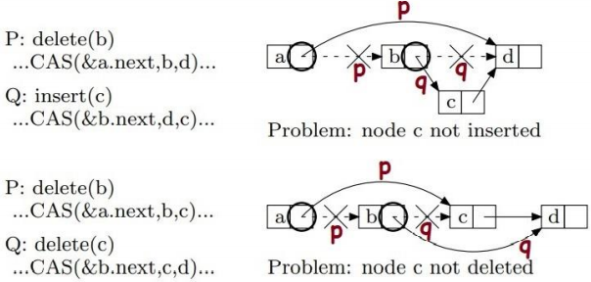
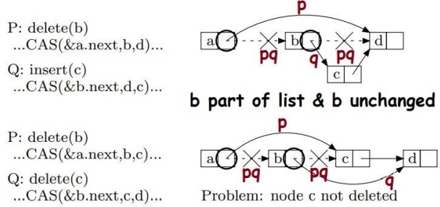
Nonblocking K-Compare Single-Swap
Victor Luchangco (Sun), Mark Moir (Sun), Nir Shavit (Tel Aviv).
Theory of Computing Systems, Springer (2008)
DOI:10.1007/s00224-008-9155-5, Corpus ID: 40581685
US7865671B2 patent assigned to Oracle America Inc (2007-08).
Why KCSS is needed?
2 extremes of software synchronization.
Compare And Swap (CAS) vs Transactional Memory (TM)
KCSS is somewhere in between.
Requires 2 CAS, 2 stores, 2k loads.
Lock-free (obstruction free), requires no barriers (TSO model).
Problems with lock-free linked-list
(Why KCSS is needed)
2CSS can be useful here

Slide 2
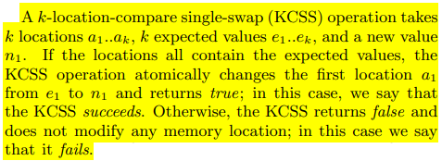
KCSS Operations
RESET(a): If address a is a tag, try replace with value.
READ(a): Read value at addres a, RESET is required.
LL(a): Load value at address a, insert new tag at a.
SC(a, n): Try replace tag at address a, with new value n.
COLLECT_VALUES(a[1..k]): READ values at addresses a[1..k].
COLLECT_TAGGED_IDS(a[1..k]): Read tags/values at addresses a[1..k].
SNAPSHOT(a[1..k]): COLLECT_TAGGED_IDS and COLLECT_VALUES in mirrored order and ensure they match before returning read values.
KCSS(a[1..k], e[1..k], n): LL first address a1 and SNAPSHOT a[2..k] and if read values match expected values e[1..k], use SC to try write value n at a1, otherwise restore old vlaue at a1 with SC.
LL: Load Linked
SC: Store Conditional
0
Value (63-bit)
Application value
1
Thead ID (15-bit)
Tag ID (48-bit)
KCSS Tag

Slide 3
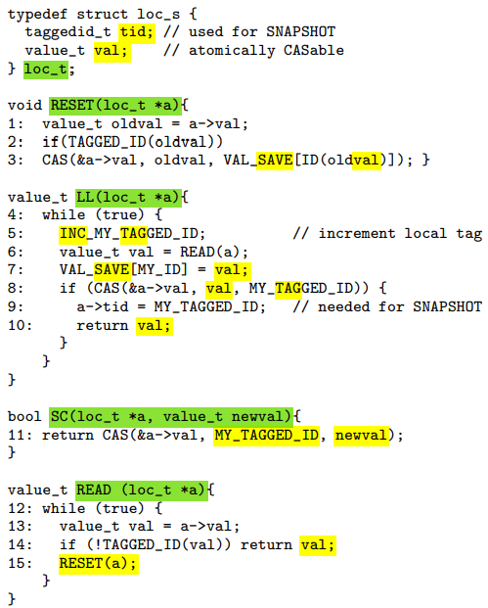
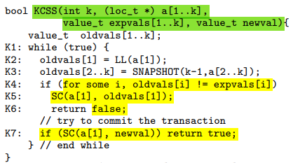
Transactions with KCSS?
KCSS can support single-write transactions.
Bank transactions are 2-reads 2-writes (2C2S).
In general transactions require k-reads k-writes (KCKS).
K-writes could be supported with k-tags (k - LL/SC).

Slide 4
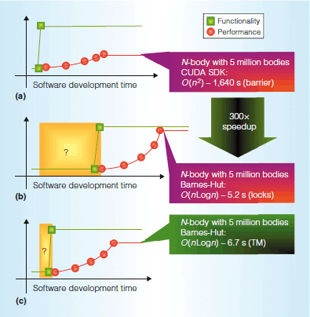
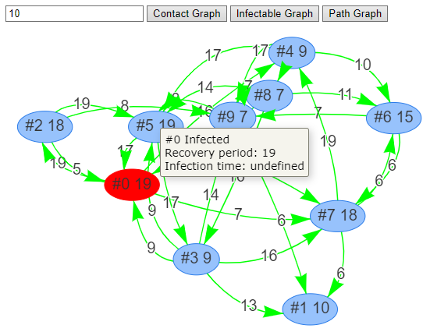
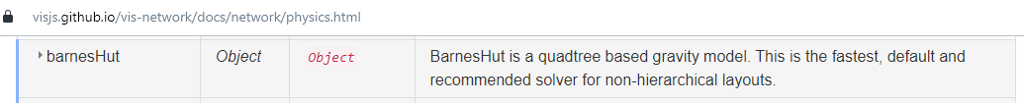
Transactional memory in GPU
N-body simulation is a simulation of a dynamical system of particles, usually under the influence of physical forces, such as gravity.
Astronomy (e.g. formation of galaxies)
Molecular Dynamics (e.g. protein folding)
Other: Fluid Dynamics, Plasma Physics, ..
Games: Kerbal Space Program

